Slide 1
INFO5990: Professional Practice in IT Week 13: Review
I value your feedback – it will help me improve the unit each semester
(the feedback from last semester’s students led to significant changes)
So – whilst you wait for the class to start – can I ask everyone to take 10 mins to complete the USS survey

Slide 2
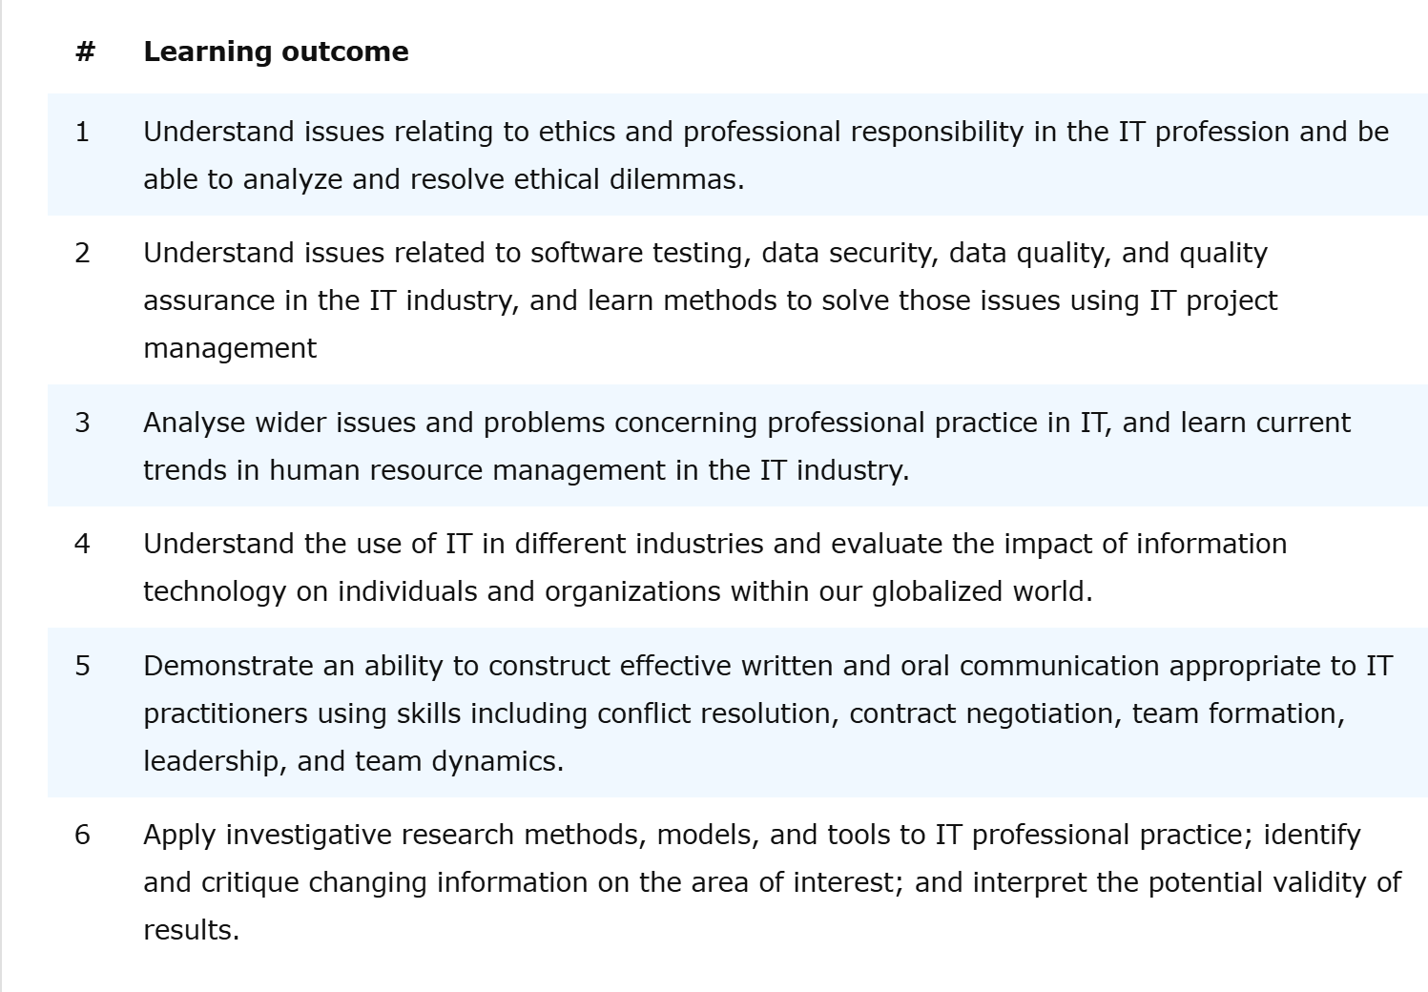
Learning Outcomes

Slide 3
INFO5990: Professional Practice in IT Week 13: The Exam…

Slide 4
Final Exam – Information Pack
General Information about exams and Special Consideration
https://www.sydney.edu.au/students/exams.html
How do I check my exam timetable?
https://www.sydney.edu.au/students/exams/timetables.html
For CC students
On-campus, paper exam
Write your answers in the provided exam booklet/bubble sheet
Allowed material
Only 1-A4 size cheat sheet of notes (double-sided, handwritten/printed, no text colour restriction)
Colour pencils/pens can be used if you want to make handwritten notes with no restrictions on text colour.
Hardcopy Bilingual dictionary (Needs to be approved by the University). Please see https://www.sydney.edu.au/students/exams/calculator-dictionary.html

Slide 5
On the day of the Exam: Special Consideration?
Special Consideration
https://www.sydney.edu.au/students/special-consideration.html
If a problem affects you completing your exam, describe it on a Student Declaration and apply for Special Consideration

Slide 6
Exam Structure
Your exam is 2 hours and 10 minutes long (130 mins).
This includes 10 minutes of reading time.
However, students who registered for a disability academic action plan will receive additional time set by the disability service team. Kindly check your Disability Academic Plan portal for more information.
You are strongly encouraged to use the “reading time” to carefully plan and structure your response before you start writing.
To pass the unit you must obtain at least 40%
Exam paper consists of 7 descriptive questions worth a total of 55 marks. Answer all questions in the spaces provided on this paper.

Slide 7
Information Pack
Focus mainly on all the topics/contents covered in weekly lecture & lecture slides
Especially Exam Practice questions are very important to secure good marks, and we already shared the sample practice questions
You must attempt all the questions
In this exam, time management is the key,
Fix 17 (120/7) minutes maximum for a question
Spend few minutes to first understand the scenario then go to attempt
Don’t leave any questions unanswered ☺, write..
Guest Presentation/Guest Lecture part is excluded from the Exam contents

Slide 8
INFO5990: Professional Practice in IT Week 13: Lectures Review

Slide 9
Week 1 - Introduction
Part A
Professions and practice
Nature of the IT industry
Professionalism
Part B
Introductions
Topics, Learning objectives, and concepts covered in the unit
Overview of the unit and assessments

Slide 10
Week 2 Creating organisational value through IT - investments
Part A: Four foundational concepts:
Organisations, value, organisational value, and IT investments
Part B: How is organisational value created? Aligning IT and business.
Organisational (business) goals, objectives and strategy
Organisational (business) models, operating models and capabilities
IT strategy, the IT operating model and IT capabilities
Orchestrating business and IT capabilities into value streams
Part C: How to represent IT value as organisational value
Part D: What does this mean for you as an IT professional?

Slide 11
Week 3 IT Lifecycle and Its Processes
A whole of lifecycle view of IT in organisations
An example of the ongoing lifecycle of a family project to acquire and operate a domestic security service
Integrating new components into the family’s interdependent systems
An example of an organisation’s processes for integrating a new IT system
Learning outcomes (able to..)
Identify and access descriptions of processes for managing the IT lifecycle

Slide 12
Week 4 - Teams
Part A: Theory
Focus: Sourcing and managing human resources; consulting and contracting; team structures.
Admin
Part B: Discussion on project success/failure

Slide 13
Week 5 – Information, Research, and Estimation
Part A: Information
Finding Information: types; location; purpose
Trusting Information
Part B: Research
Statistics
Types of research
Business analytics
Part C: Project Estimation
Understand general approaches to estimating project size ad effort…
… and then explore what this means for organisational IT
Question: How many of your project failures involved the project taking much more effort / costing much more than expected???

Slide 14
Week 6 – Quality Assurance
Project Quality Assurance - Concepts
How do you measure the quality of a project?
How do you ensure the quality of a project?

Slide 15
Week 7 – Software Testing
Testing Management - Software Testing - how much is enough (in different environments)? - Managing testing; responsibilities - Case Study

Slide 16
Week 8 - Security Management
Security Management
Not focusing on:
Security tools / Techniques
Rather, focusing on: • Appreciation of the importance of managing security • Understand the sort of difficulties encountered in security in large software systems
Case Studies
Discussion…

Slide 17
Week 9 – Security Management 2
Security Management 2
Cybersecurity vs information security
GDPR
Business continuity vs disaster recovery
Security planning
Asset protection;
Mitigation approaches
Cloud computing
MFA

Slide 18
Week 10 - Communication
Writing & Presenting – To convince and persuade – For IT Professionals
Your Project – Who is your audience? – What information will they want? – What key messages do you want them to understand?

Slide 19
Week 11 - Ethics
Do you know right from wrong? Always?
How do you decide?
What do you do about it?
Is it different in the workplace to in your personal life?
How do you judge other people/ companies/ groups ethics?
What happens when your ‘wrong’ is someone else’s ‘right’?
Covered:
Theories
Scenarios
Case Studies
A broader look at ethics in Information Technology

Slide 20
Week 12 – 13 Guest Lecturer Discussion
TPG (Risk Management in IT)
OPTUS (Professional Practices in IT)

Slide 21
Thank you!
I hope you have enjoyed the semester. And more importantly, have achieved strong learning that proves to be valuable for you.
And all the best for the final exam

